Slide 1
E-Exam For Specific Subject(OSS)
Team Members :
1- Abdallah Mahnna Mohammed
2- Ahmed Eid Attiya

Slide 2
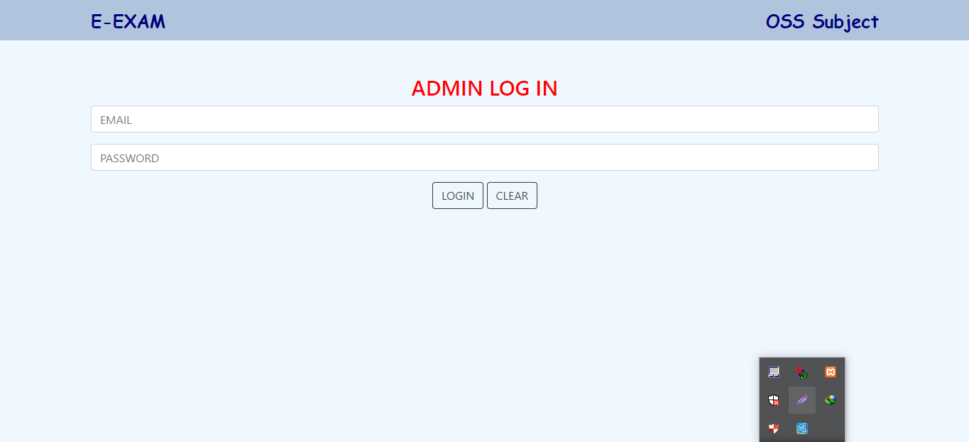
Log in to The Admin or Professor’s Account e-mail: dramr111@gmail.com password: 123456

Slide 3
Admin Dashboard
Add Student
Show All Student
Delete Student
Add Questions to any Exam
And add them options
Delete Question
Determine the correct Answer

Slide 4
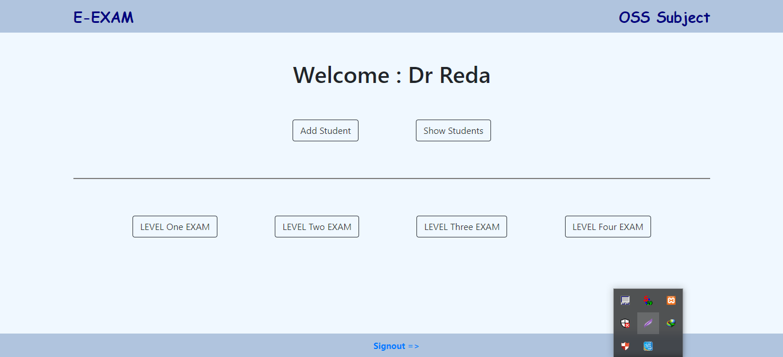
Admin Dashboard

Slide 5
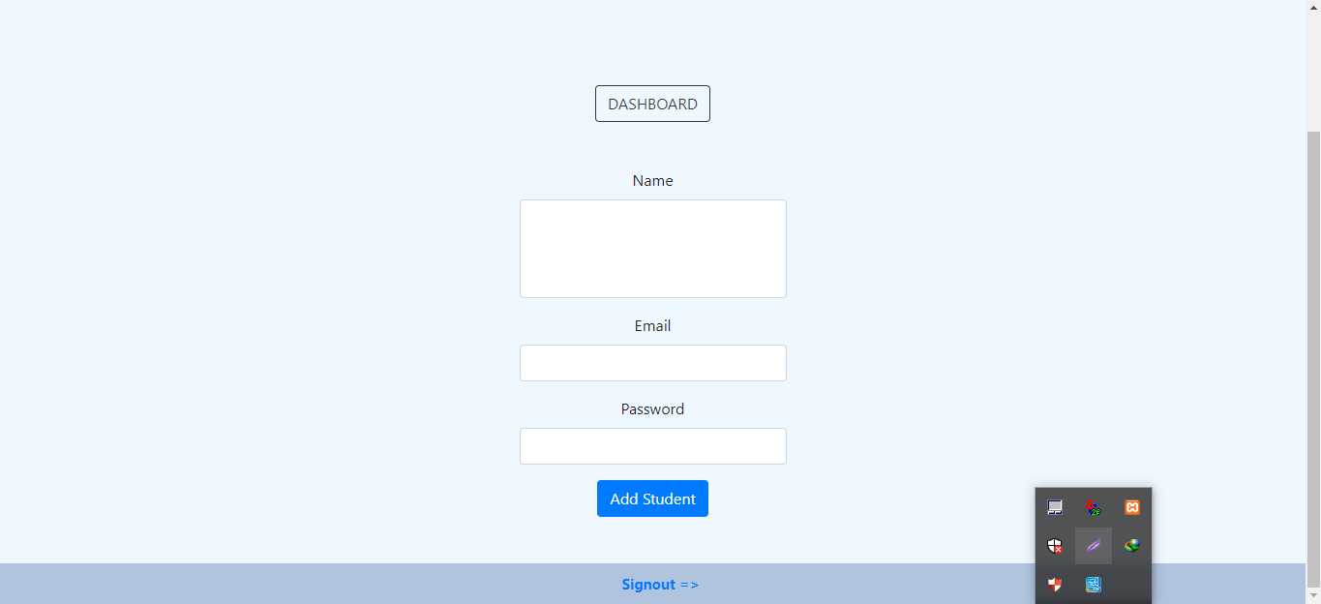
Add Student admin or professor must Enter student name , his E-Mail and password Before press add student Button

Slide 6
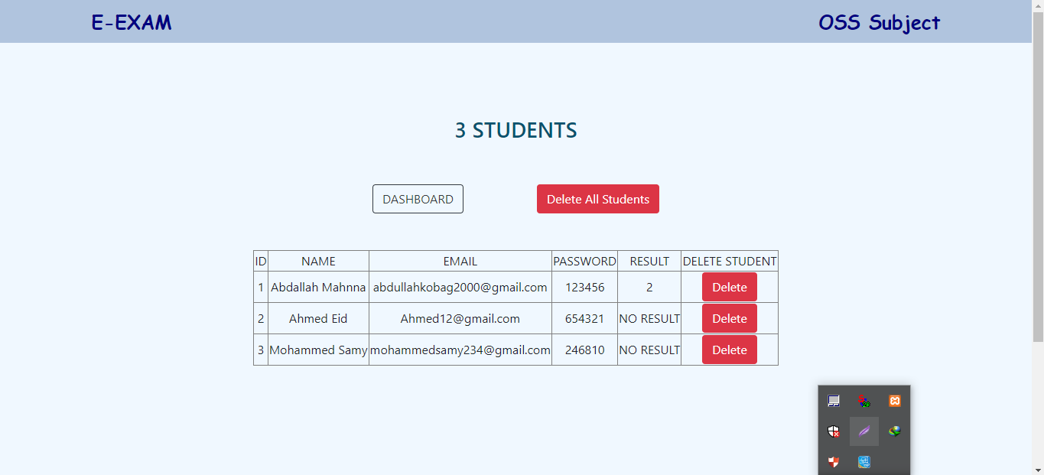
This Slide Show How The Admin or Professor See the Information of Students and can Delete any Student

Slide 7
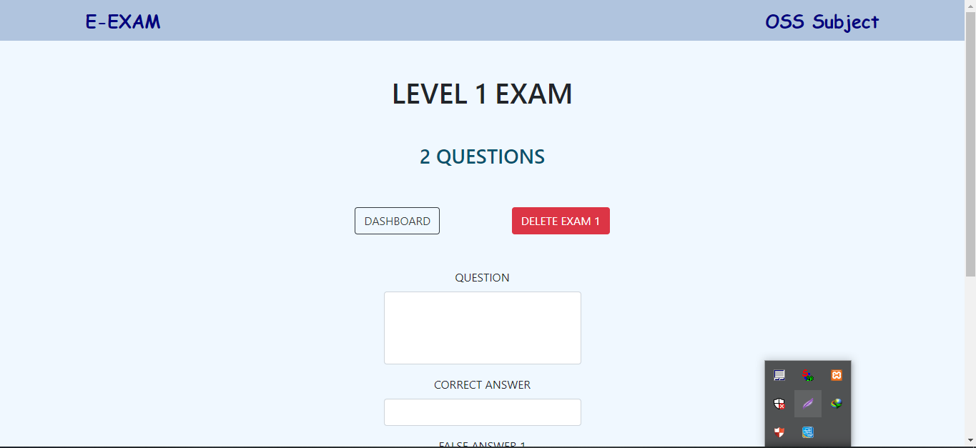
And this Two Slides show How The Professor add Questions to Any Exam and add them options.

Slide 8
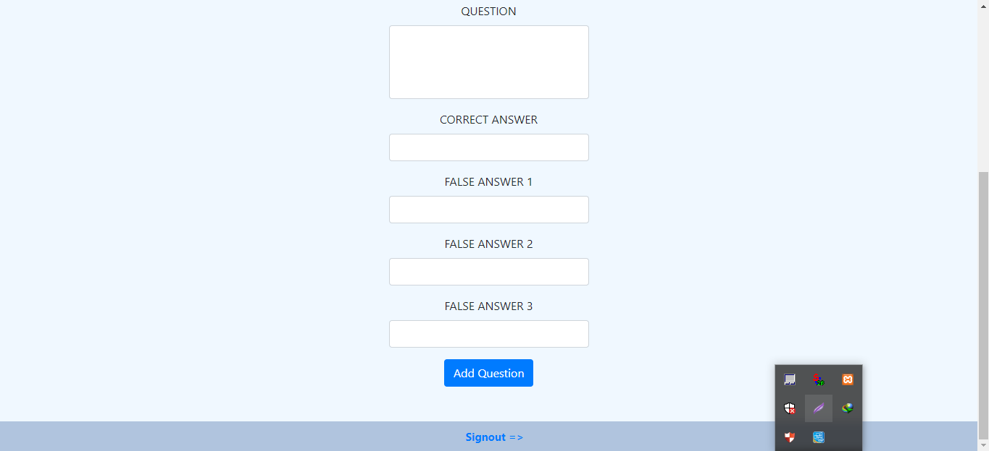

Slide 9
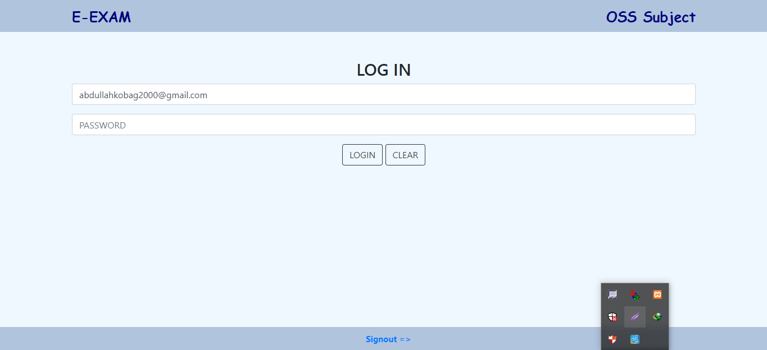
Log in to The Student’s Account e-mail : abdullahkobag2000@gmail.com password: 123456

Slide 10
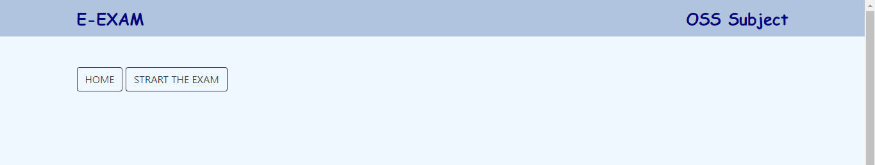
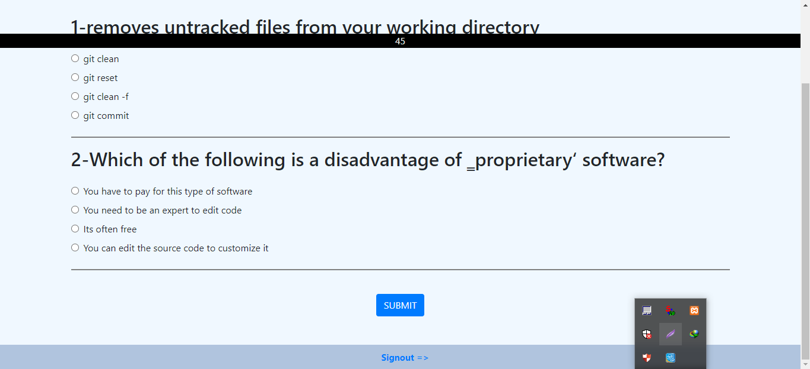
This Slide Show How student can start his Exam and take the exam at a period of time

Slide 11
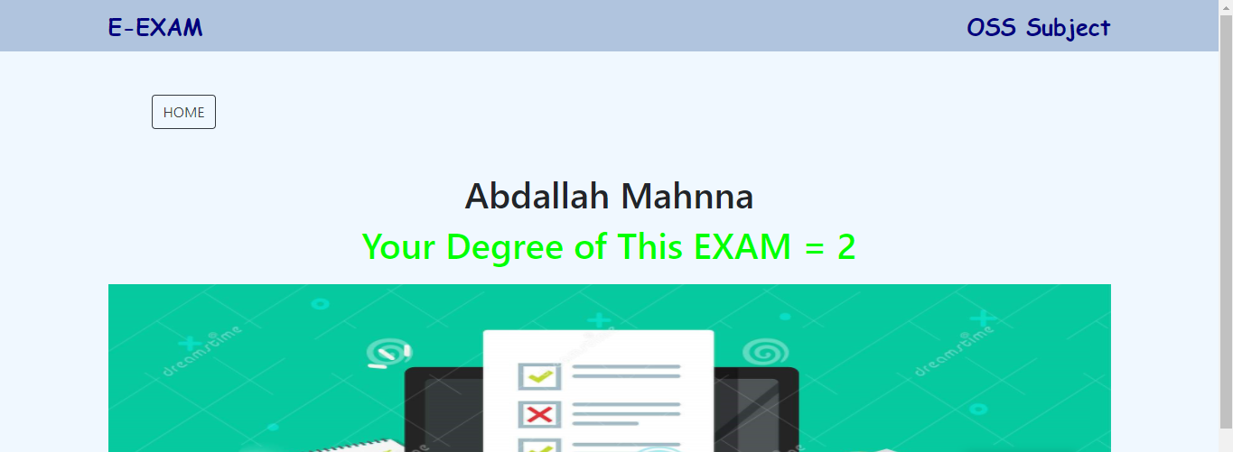
When any Student Finishing his Exam he can see his Result of This Exam

